Slide 1
Geology
Justin P. Jones

Slide 2
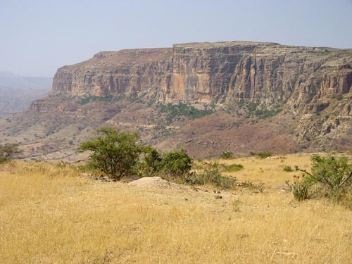
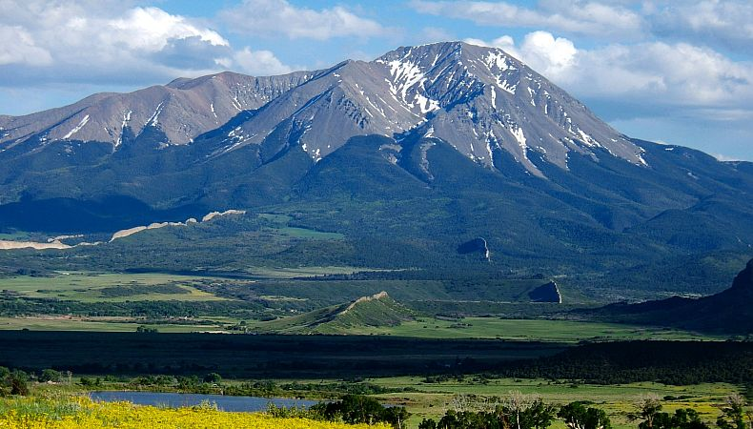
The World is a canvas
A geologist examines the many stories told by the Earth’s rocks and minerals.
They notice the subtle differences between different rock formations and strive to paint the complete picture of Earth’s history.

Slide 3
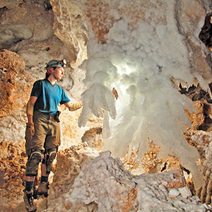
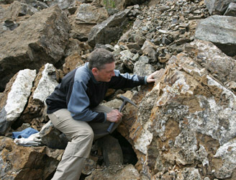
Geology
Geology is the field of science that seeks to tell the history of the Earth as told by its rocks and minerals

Slide 4
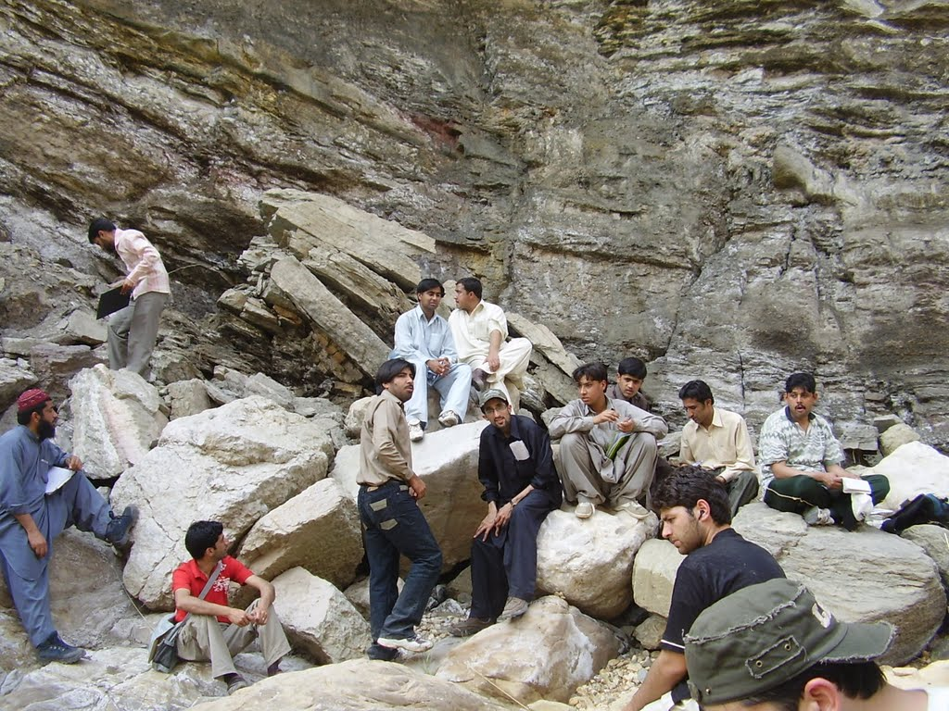
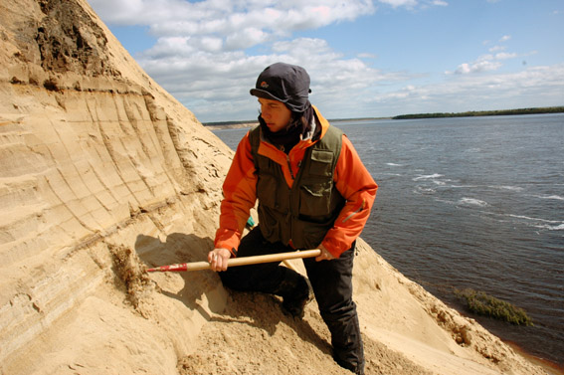
Qualities of a Geologist
Geologists have to be intelligent, considering the fact that they are scientists.
They must also be somewhat sociable, since they will often be doing research with teams of other geologists
Geologists must also be able to teach, since they will most likely be university professors.

Slide 5
Education
Like all other scientists, geologists spend most of their 20’s in college.
In order to work (research) in geology, one must obtain a Bachelor’s, Master’s, and Doctorate degree in the subject
Commercial geologists often require less schooling.

Slide 6
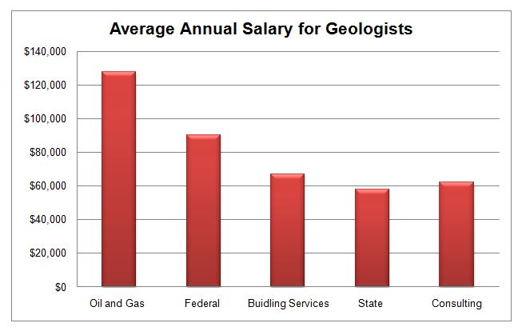
Benefits and Salary
Geology professors earn an average of $92,753 annually.
Geologists in other fields of employment earn different salaries.
Professors get time off in summers, and get their research funded by universities.

Slide 7
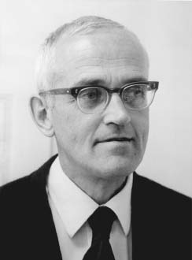
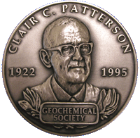
The Earth
Since our time on this planet, humans have wondered just how old our planet is.
A geochemist named Clair “Pat” Patterson sought to find the true answer to this question (prior to his research, the Earth was thought to be only a few thousand years old).
By calculating the half-life (decay rate) of lead atoms on a meteorite the same age as the Earth, he was able to tell the Earth’s age, which is 4.5 billion years.

