Slide 1
Ally Hippler
P.3

Slide 2
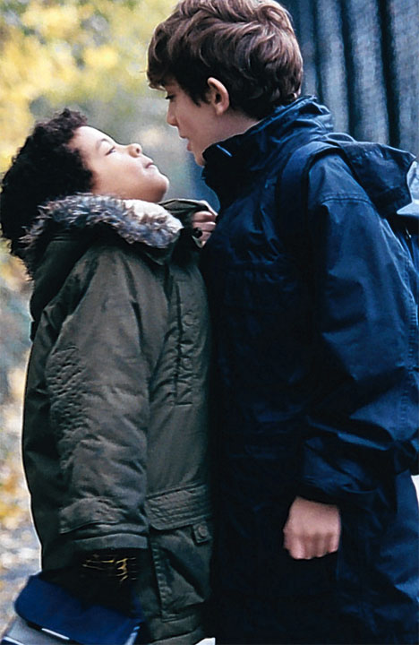
Bad behavior
Unhappy
Laughing
Lying
Yelling
Individual
Name – calling
Gossiping

Slide 3
Who’s Targeted?
Older teens are more likely to be targets of bullying online.
13% (people) reported that they have had rumors spread about them.
31% (people) reported being targeted by rude or mean comments.
9% (people) reported that they have felt threatened by someone online.
4% (people) reported that someone has used the internet to threaten or embarrass them.
14% (people) reported being targeted by threatening or mean comments.

Slide 4
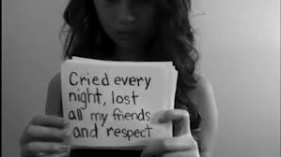
What to do
Don’t be shy, tell an adult.
Don’t just watch or be a bystander, tell a teacher.

Slide 5
What is Cyberbullying?
Defined as:
- threatening to hurt you or beat you up
- threat or offensive online behavior.
- a hurtful message on email, IM or social networking site.
- A rumor posted on your profile page or spread.

Slide 6
Resources
http://www.stopbullying.gov/cyberbullying/index.html | http://www.stopcyberbullying.org/index2.html | http://www.ncpc.org/topics/cyberbullying
This website includes the definition of cyber bullying, how to stop it, who to ask or talk to and how to respond to it. | This website includes the definition, telling you to take action, and how to stop it. | This website includes the definition, what you can do, tips, and how parents can help.

