Slide 1
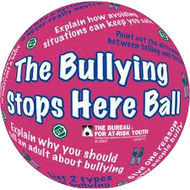
Cyber Bullying
By: Courtney Schwarz
Period 4

Slide 2
Do you know how bad cyber bullying can hurt someone? It can hurt them really bad.

Slide 3
Introduction
My project is about cyber bullying and how it can really hurt people.

Slide 4
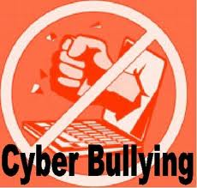
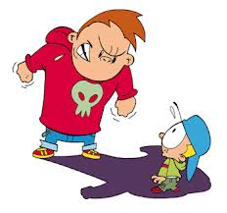
Suicide
People commit suicide because of being bullied not just cyber bullying but all types of bullying, you may think it is funny but in reality it isn't.

Slide 5
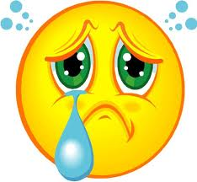
BULLYING….
BECAUSE OF HOW THEY LOOK,
UGLY,
LIVING HELPLESS,
LOSER,
YOU ARE SO UGLY,
INSULTS,
NOBODY LIKES YOU,
GET A LIFE.

Slide 6
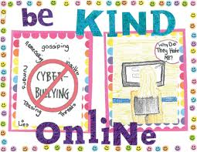
Be Kind Online….

Slide 7
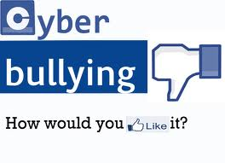
How would you like it????

Slide 8
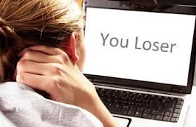
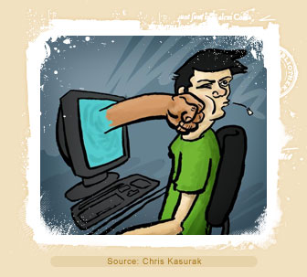
If you can do it online, then try to say it to their face….

Slide 9
Websites:
http://www.stopcyberbullying.org/: it tells you where cyber bullying happens, how it happens why it happens, etc.
http://cyberbully411.org/: it tells you what cyber bullying is, who is targeted, and who the cyber bullies are.
http://www.cyberbullying.us/:The Cyber bullying Research Center is dedicated to providing up-to-date information about the nature, extent, causes, and consequences of cyber bullying among adolescents. Cyber bullying can be defined as "willful and repeated harm inflicted through the use of computers, cell phones, and other electronic devices."

Slide 10
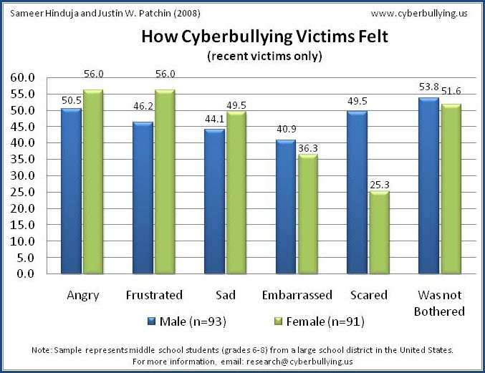
Statistics

Slide 11
Conclusion
My project was about how cyber bullying can affect everyone in about 100 ways or more. Cyber bullying has made so many people feel so many different emotions they have probably never experienced in their lifetime. Many people have killed themselves from all types of bullying ( cyber, relational, physical, mentally, etc.)

Slide 12
Videos
http://www.nsteens.org/videos/cyberbullying
http://www.onguardonline.gov/media/video-0005-stand-cyberbullying
http://www.youtube.com/watch?v=-5PZ_Bh-M6o

